Slide 1
Software Engineering and Architecture
Systematic Testing
Equivalence Class Partitioning

Slide 2
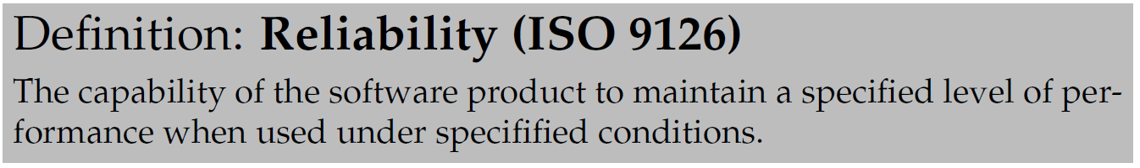
What is reliability?
If there is a defect, it may fail and is thus not reliable.
Thus:
  Reduce number of defects
  … will reduce number of failures
  … will increase reliability

Slide 3
Discussion
True?
  Find example of removing a defect does not increase the system’s reliability at all
  Find example of removing defect 1 increase reliability dramatically while removing defect 2 does not
Notes:
A friend came with a word document – ready to hand-in – but some plug-in prevented word from saving the document

Slide 4
All defects are not equal!
So – given a certain amount of time to find defects (you need to sell things to earn money!):
What kind of defects should you correct to get best return on investment?

Slide 5
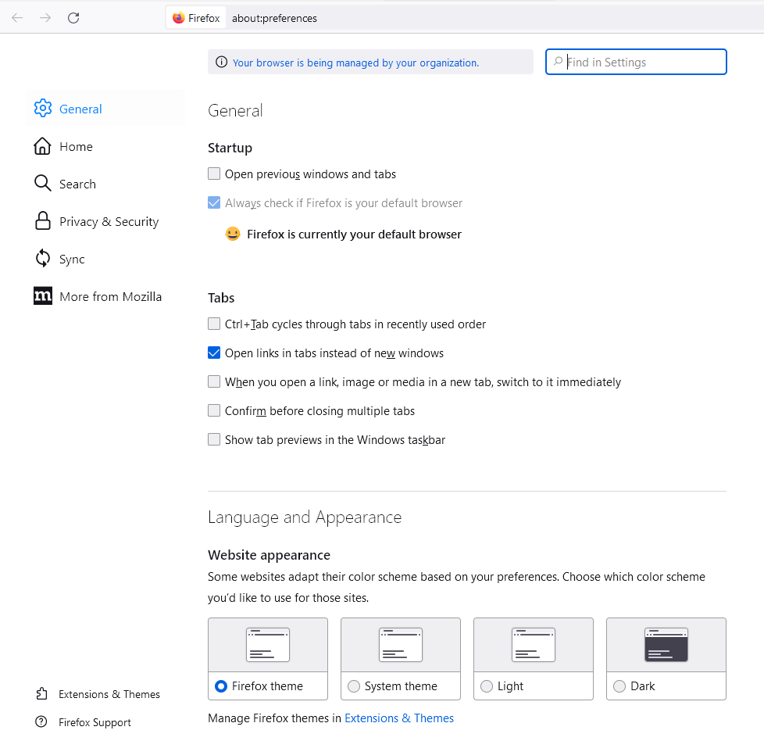
Example
Firefox has an enormous amount of possible
configurations! Imagine testing all possible combinations!
Which one would you
test most thoroughly?

Slide 6
Testing Techniques

Slide 7
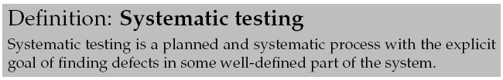
One viewpoint
The probability of defects is a function of the code complexity. Thus we may identify (at least) three different testing approaches:
  No testing. Complexity is so low that the test code will become more complex or longer. Example: set/get methods
  Explorative testing: “gut feeling”, experience. TDD relies heavily on ‘making the smart test case’ but does not dictate any method.

Slide 8
Destructive!
Testing is a destructive process!!!
  In contrast to almost all other SW processes which are constructive!
Human psychology
  I want to be a success
    The brain will deliver!
      (ok, X-factor shows this is not always the case…)
I will prove my software works
I will prove my software is really lousy

Slide 9
Morale:
When testing, reprogram your brains
I am a success if I find a defect.
The more I find, the better I am!

Slide 10
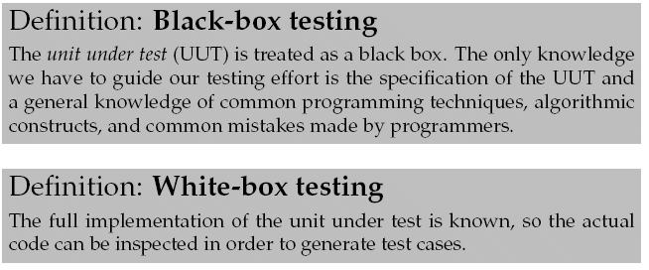
Our focus
There are a lot of different testing techniques.
Types:
In our course – two black box techniques:
  Equivalence class partitioning (EC)
  Boundary value analysis (which is actually associated with EC)

Slide 11
Equivalence Class Partitioning
(Da: Ækvivalensklassepartitionering)
Often just called EC testing…

Slide 12
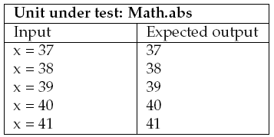
Consider
Math.abs(x): Absolute value of x;
  Examples: abs(-2) = 2; abs(7) = 7;
  If x is not negative, return x.
  If x is negative, return the negation of x.
Will these five test cases ensure a reliable implementation?

Slide 13
Two problems
A) what is the probability that x=38 will find a defect that x=37 did not expose?
B) what is the probability that there will be a defect in handling negative x?

Slide 14
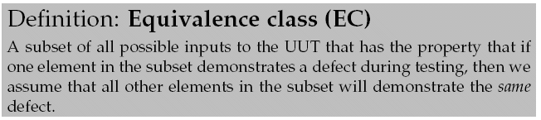
Core insight
We can find a single input value that represents a large set of values when it comes to finding defects!
So – we only need one test case representing that set
An EC is a (sub)set of all inputs.
Da: Delmængde

Slide 15
For Math.abs
ECs are subsets of the full input set.
-42
+39
-92431523
+37
EC-1
EC-2
X = - 42 | 42

Slide 16
The argumentation
The specification will force an implementation where (most likely!) all positive arguments are treated by one code fragment and all negative arguments by another.
  Thus we only need two test cases:
    1) one that tests the positive argument handling code
    2) one that tests the negative argument handling code
For 1) x=37 is just as good as x=1232, etc. Thus we simply select a representative element from each EC and generate a test case based upon it.

Slide 17
Note
Systematic testing ...
does not mean
  Systematically find all defects and guaranty none are left!!!
    If you need proofs, you need my colleagues’ research ☺
does mean
  Systematically derive a small set of test cases with high probability of finding many defects!!!

Slide 18
Specifically
Systematic testing cannot in any way counter malicious programming
  Virus, easter eggs, evil-minded programmers
  (really really incompetent programmers)

Slide 19
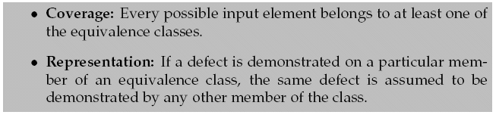
A Sound EC partitioning
For our EC partitioning to be sound:
Exercise
  Why the word ‘assumed’ in the above statement?
    Why not ‘guarantied’ ?
Notes:
Answer: It is a black box test – we do not know the actual code, so we can only assume the representation aspect in our analysis

Slide 20
Exercise
Coverage? Representation?
-42
+39
-92431523
+37
EC-1
EC-2

Slide 21
Exercise
The classic blunder at exams!
  Representation = two values from the same EC will result in the same behaviour in the algorithm
Argue why this is completely wrong!
  Consider for instance the Account class’ deposit method…
    account.deposit(100);
    account.deposit(1000000);

Slide 22
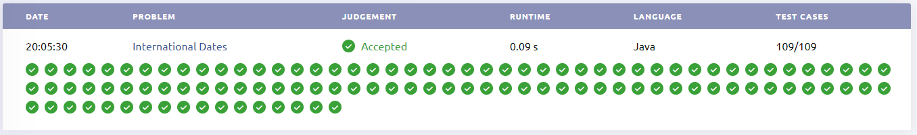
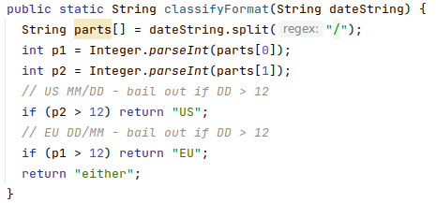
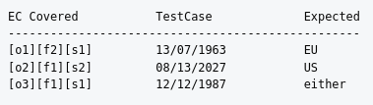
SideBar
Open.kattis // Exercise International Dates
109 test cases for
five lines of code???
My analysis:
  3 test cases is enough!

Slide 23

Documenting ECs
Math.abs is simple. Thus the ECs are simple.
This is often not the case! Finding ECs requires deep thinking, analysis, and iteration.
Document them!
Equivalence class table:
Label the EC

Slide 24
Invalid/Valid ECs
Some input values make an algorithm give up, bail out, throw exception, or compute answer immediately:
  file.open(“nonexisingfile”);
  game.usePower(FINDUS) (and findus mana =0)
Input values that leads to abnormal processing/bail out, we classify as belonging to invalid ECs.
Those input values that process normally/all the way, we say belong to valid ECs.
  Those cases where the ‘method is run to conclusion’
Bail out fast

Slide 25
Finding the ECs
Often tricky…

Slide 26
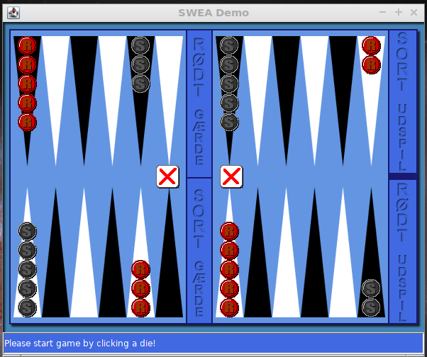
Reality
Example: Backgammon move validation
  validity = v (move, player, board-state, die-value)
    is Red move (B1-B2) valid on this board given these die values and this player in turn?
  Problem:
    multiple parameters: player, move,
    board, die
    complex parameters: board state
    coupled parameters: die couples to move!
      EC boundary is not a constant!

Slide 27
A process
To find the ECs you will need to look carefully at the specification and especially all the conditions associated.
  Conditions express choices in our algorithms and therefore typically defines disjoint algorithm parts!
    If (expr) {} else {}
  And as the test cases should at least run through all parts of the algorithms, it defines the boundaries for the ECs.
… And consider typical programming techniques
  Will a program contain if’s and while’s here?

Slide 28
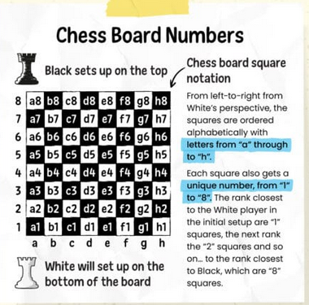

Partitioning Heuristics
1) If you have a range of values specification
  make three ECs:
    [1] in range valid
    [2] above range invalid
    [3] below range invalid
Ex. Standard chess notation/ is “a8” or “x17” valid positions?
  Column range: a-h; Row range: 1-8
public boolean valid(char c, int r);

Slide 29

Partitioning Heuristics
2) If you have a set, S, of values specification
  make |S|+1 ECs
    [1] .. [|S|] one EC for each member in S valid
      Each with only that particular member in the set
    [|S|]+1 for all values outside S invalid
Ex. PayStation accepting coins
  Set of {5, 10, 25} cents coins
  Note: Not just two sets!

Slide 30

Partitioning Heuristics
3) If you have a boolean condition specification
  make two ECs
Ex. the first character of identifier must be a letter
the object reference must not be null
  you get it, right?☺

Slide 31
Partitioning Heuristics
4) If you question the representation property of any EC, then repartition!
  Split EC into smaller ECs
Examples: shortly ☺

Slide 32
From ECs to Test cases

Slide 33

Test case generation
For disjoint ECs you simply pick an element from each EC to make a test case.
Document in a Extended test case table
Augmented with a column showing which ECs are covered!

Slide 34
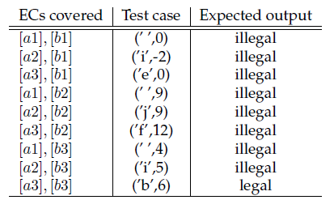
Usual case
ECs are seldom disjoint – so you have to combine them to generate test cases.
Ex. Chess board validation
public boolean valid(char c, int r);

Slide 35
Combinatorial Explosion
Umph! Combinatorial explosion of test cases ☹.
Ex.
  Three independent input parameters foo(x,y,z)
  Four ECs for each parameter
    That is:
      x’s input set divided into four ECs,
      y’s input set divided into four ECs,
    etc.
Question:
  How many test cases?

Slide 36
Combinatorial Explosion
Answer: 4³ = 64 test cases…
TC1: [ECx1],[ECy1],[ECz1]
TC2: [ECx1],[ECy1],[ECz2] …
TC4: [ECx1],[ECy1],[ECz4] …
TC5: [ECx1],[ECy2],[ECz1] …
TC9: [ECx1],[ECy3],[ECz1] …
…
TC64: [ECx4],[ECy4],[ECz4]

Slide 37
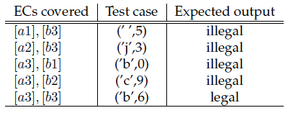
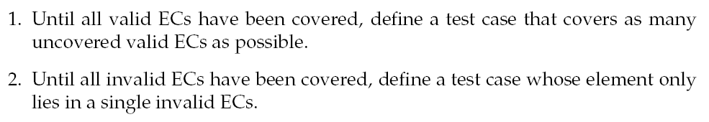
Myers’ Heuristics
Often, it is better to generate test cases like this:
Rule 2
Rule 1

Slide 38
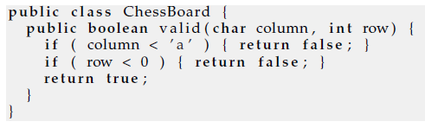
Why Rule 2?
Due to masking
  One correct test masks a later incorrect test
Ex.
This test case will pass which is expected
  Thus, code is deemed correct, but this is a wrong conclusion!
    It was the ‘column’ test that returned ‘false’ so the defect in the row conditions is masked
Defective code
but test pass ☹
False positive
assertThat(b.valid(‘ ‘,0)), is(false));

Slide 39
Why Rule 1?
You may combine as many valid ECs as possible and cover it with only a single test case until all valid ECs are exhausted…
Why?
Because I must assume that all elements from ECs are used to compute the final result. Any defects will thus most likely show up even if the defect only relate to one element.
Ex. bankdayNumberInYear(int month, int day)
  return 30*month+day
Jan = 1; Feb = 2
Notes:
Even a single testcase like (3,1) = March 1st will detect that the algorithm above is wrong because the two parameters are both used in computation. Another wrong algorithm like “30*(month-1)+day-1” would also be detected only by a single testcase etc.

Slide 40
The Process
The Summary

Slide 41
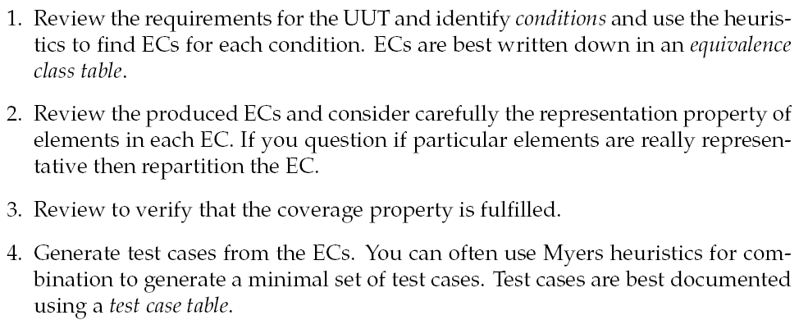
Revisited…
5. Review the generated test cases carefully to find what you missed – and iterate!

Slide 42
An Example
Phew – let’s see things in practice

Slide 43
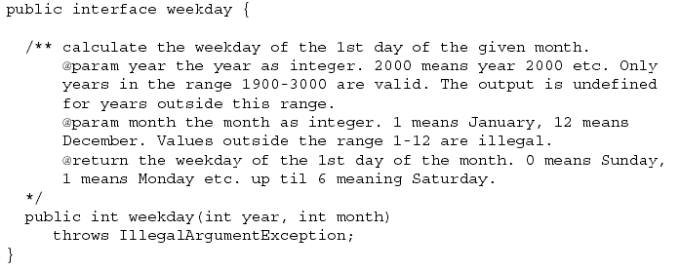
Example

Slide 44
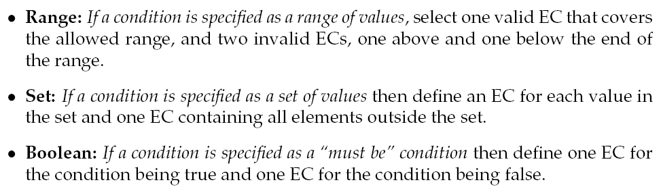
Exercise
Which heuristics to use on the spec?

Slide 45
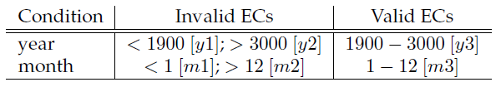
Process step 1
Result

Slide 46
Process step 2
Review and consider representation property?

Slide 47
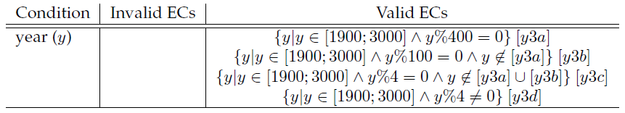

Damn – Leap years!
Nice to be an astronomer ☺
What about the months? Let’s play it safe…
(as before)

Slide 48
Process step 3
Coverage?

Slide 49
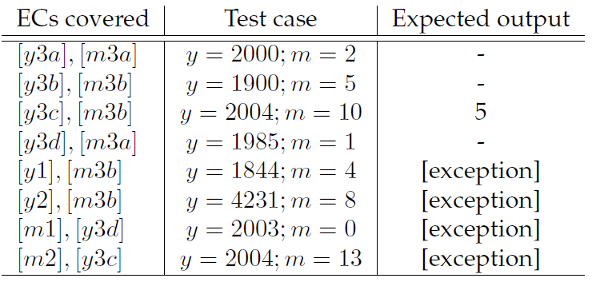
Process step 4
Generate, using Myers rule 1 and rule 2
Conclusion: Only 8 test cases for a rather tricky alg.

Slide 50
Example 2

Slide 51
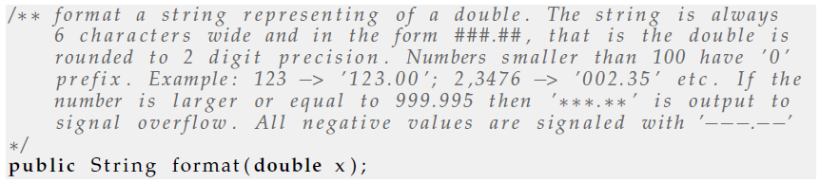
Formatting
Note! Most of the conditions do not really talk about x but on the output.
Remember: Conditions in the specs!!!

Slide 52
Exercise
What do we do?
Range? Boolean? Set?
Valid / Invalid ECs?

Slide 53
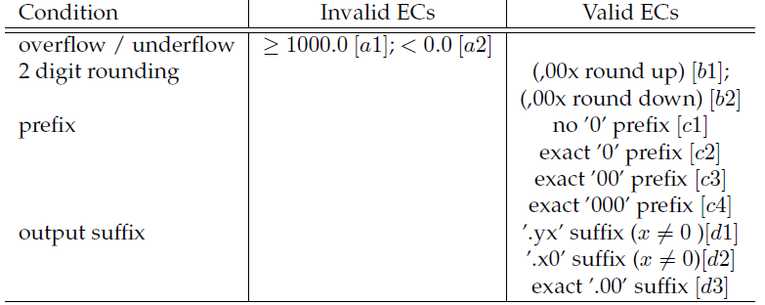
My analysis
range
0.0 <= x < 1000.0 [a3]
boolean
set
set

Slide 54
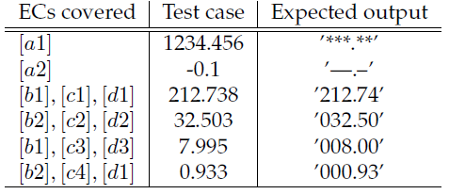
Test cases

Slide 55
Process Recap

Slide 56
Process Recap

Slide 57
Process Recap

Slide 58
Process Recap

Slide 59
Process Recap

Slide 60
Process Recap

Slide 61
Often, Alternative Analysis Possible
I used ‘set’ heuristics to divided the ‘prefixed 0’ ECs
A range heuristics could be applied just as well
  Condition
    Whole part of decimal number x, let call it w
  Intervals
    w in [100..999] [b1]
    w in [10..99] [b2]
    w in [1..9] [b3]
    w is [0] [b4]
(Note: all these are VALID ECs)
Will lead to the exact same test cases…

Slide 62
Computations
“Code without if’s”
… also requires some care

Slide 63
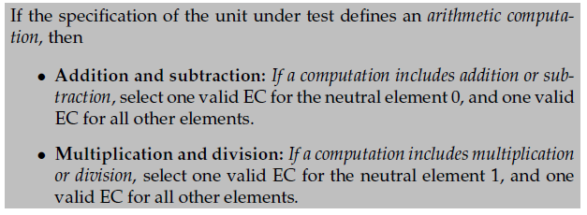
Computation Heuristics
Computations have their own pitfalls: 0 and 1

Slide 64


Example
Specification:
But: No conditions =>
  Myers analysis will give only one test case =>
    Could just be a = x = b =0
Thus will not detect that the function below is wrong!
Notes:
Note that the a=x=b=0 is a correct test case according to our partitioning heuristics!

Slide 65
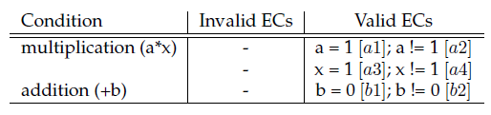
Example
Specification:
Our computation
heuristics thus leads to:
Testcase: a=7; x= 3; b=9 => output = 30.
Note: the neutral element ECs need not be tested at all!
Notes:
Note that the a=x=b=0 is a correct test case according to our partitioning heuristics!

Slide 66

Computation Heuristics
Example/Hint – SigmaStone attacks with field support
+1 for every friendly minion of same class
  Range [0..4] + >= 5
  Implementation 1:
    Value = attackStrength + sumOfFriendlyOfSameClass();
  Implementation 2:
    Value = attackStrength; // missing the summation here
Picking 0 as representative element is problematic!

Slide 67
Boundary value analysis
Adding corner cases of ECs

Slide 68
Boundary value analysis
Experience shows that test cases focusing on boundary conditions have high payoff.
Some that spring into my mind are
  ”off by one” errors in comparisons
    if ( x <= MAX_SIZE ) and not if ( x < MAX_SIZE )
  null as value for a reference/pointer

Slide 69
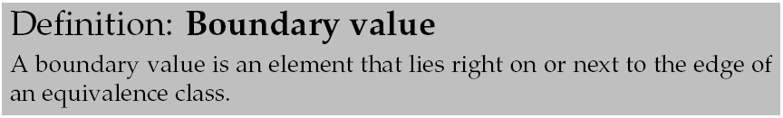
Complements EP analysis
Ex. Formatting has a strong boundary between EC [a1] and [a2]
  0.0 (-> ‘000.00’) and -0.000001 (-> ‘---.--’)
It is thus very interesting to test x=0.0 as boundary.

Slide 70
Other Reliability Techniques
Testing is not the only way…

Slide 71
Systematic Review
Systematic Review
  A formalized, systematic, process of people reading the code and identifying anomalies
    Pro:
      Can find defects that no testing ever can
        Wrong comments
        Architectural flaws (‘strategy is used incorrectly here’)
      Important learning
        Learn by reviewing the code of master coders
    Con:
      Manual/human/slow/expensive
      Regression is too expensive
      Bottleneck in releasing software

Slide 72
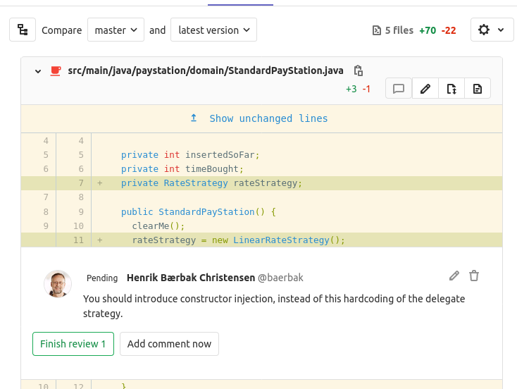
Systematic Review
Supported by GitHub, etc
MicroSoft embraces review

Slide 73
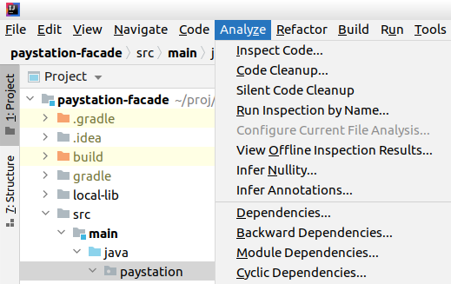
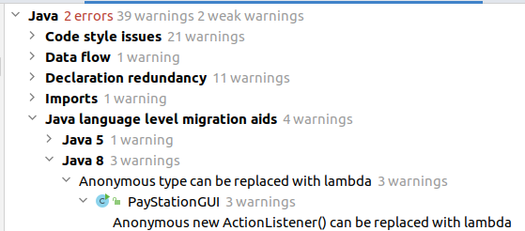
Static Analysis
Static Analysis
  A review, but a program does it, using heuristics encoded

Slide 74
Static Analysis
Static Analysis
  Pro
    Fast and automated
    Especially suited to find security flaws
  Con
    Restricted in the types of failures it can find
      Primarily language level errors, not on architectural level
    Overload of errors
      I review many and find they are not errors but ‘as I want it’
      But they pop up every time I run the analysis => error blindness
        The one that I should have picked up drowns in all the information…

Slide 75
Formal Methods
The biggest gun in the cupboard
Mathematical proof that our algorithm is correct
Much research (also here at CS), but so far (I think)
  Techniques do not scale well
  Math may be even harder to read than code
    That is, the error may be in the proof!
  Math is a model, often ignoring physical properties
    No, the Stack is not infinite! No, memory is not infinite!
    No, the network is not infinitely fast, etc…

Slide 76
Discussion

Slide 77
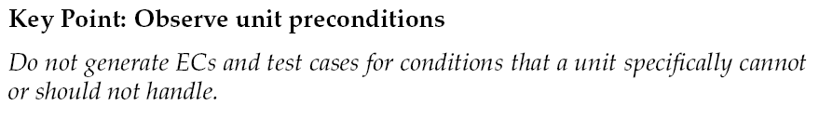
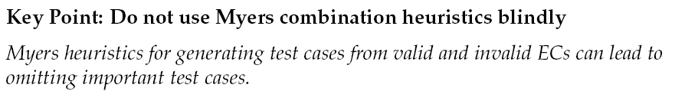
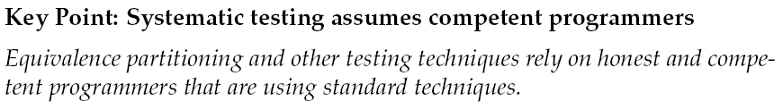
A few key points

Slide 78
Summary
Equivalence Class Partitioning
  EC = set of input elements where each one will show same defect as all others in the same set (representation)
  Find ECs, use Myers to generate test cases.
Boundary analysis
  Be skeptical about values at the boundaries
  Especially on the boundary between valid and invalid ECs

